Slide 1
Jean-Claude Van Damme Doin’ The Splits’
Yomi Defense
Jean-Claude Van Damme Doin’ The Splits’
Yomi Defense
Jeremiah Morse, Jacob Lyon, Donald Hawkins
Jeremiah Morse, Jacob Lyon, Donald Hawkins

Slide 2
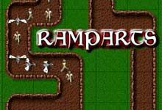
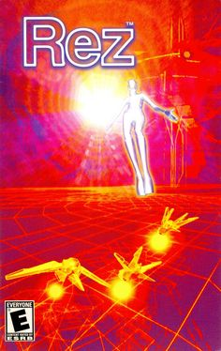
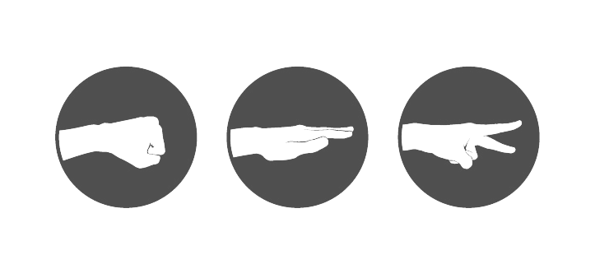

What is Yomi Defense?
What is Yomi Defense?
2-Player Rhythm Puzzle Defense
Yomi - “Knowing the mind of the opponent”
Synesthetic Vaporwave style
2-Player Rhythm Puzzle Defense
Yomi - “Knowing the mind of the opponent”
Synesthetic Vaporwave style

Slide 3
Basic Rules
Basic Rules
Waving player selects 1 of 3 preset starting points and 1 of 3 preset end points
Waving player sets waypoints with mouse clicks: LButton real, RButton fake
Vaping player sets towers with type
Wave commences, Vaping player controls detection light, Waving player can activate short-circuit ability (wave heads directly for goal for short period)
Roles reverse for next round.
Scores based on wave objects destroyed/cleared, highest score wins
Waving player selects 1 of 3 preset starting points and 1 of 3 preset end points
Waving player sets waypoints with mouse clicks: LButton real, RButton fake
Vaping player sets towers with type
Wave commences, Vaping player controls detection light, Waving player can activate short-circuit ability (wave heads directly for goal for short period)
Roles reverse for next round.
Scores based on wave objects destroyed/cleared, highest score wins

Slide 4
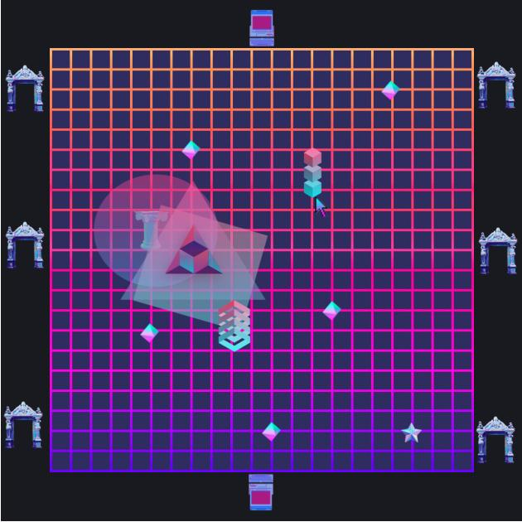
Prototype Sketch
Prototype Sketch

Slide 5
Technical Requirements Specifications
Technical Requirements Specifications
Scenes: Menu (Song Select/Difficulty), Game Level (1 Per Player), Outcome
Complexity: 3 Wave objects, 3 Towers w/ Projectiles, 3 Spawn/Goal Points
Camera Views: Main, Wave Tracking Small
Behavior/Physics: Tower Targeting, Automatic Wave Path, Exploding Wave Objects Impact Other Objects (COMBOS!), Object Shaking/Effects with Music
Lighting/Particles: Towers emit light source and particle projectiles, Players control lighting sources during wave run
Scenes: Menu (Song Select/Difficulty), Game Level (1 Per Player), Outcome
Complexity: 3 Wave objects, 3 Towers w/ Projectiles, 3 Spawn/Goal Points
Camera Views: Main, Wave Tracking Small
Behavior/Physics: Tower Targeting, Automatic Wave Path, Exploding Wave Objects Impact Other Objects (COMBOS!), Object Shaking/Effects with Music
Lighting/Particles: Towers emit light source and particle projectiles, Players control lighting sources during wave run

Slide 6
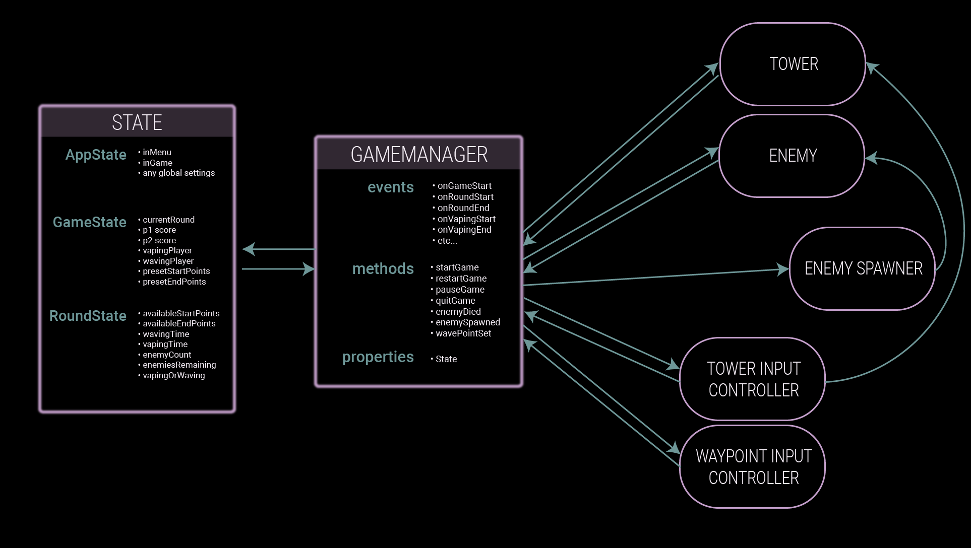

Slide 7
Schedule
Schedule
28 Feb - Scenes, Basic placeholder objects/behavior, GameManager, State
02 Mar - Multiple object types, Object interaction, Small View
03 Mar - Demo Prep
04 Mar - Progress Demo
05 Mar - Extra Interaction / Music Behavior
07 Mar - Lighting/Particles
09 Mar - Lighting/Particles
11 Mar - Playtest
12 Mar - Incorporate Feedback, Finalize Design
13 - 17 Mar - Balance adjustments, Bug Fixes, Stretch Goals
18 Mar - Final Gameplay
28 Feb - Scenes, Basic placeholder objects/behavior, GameManager, State
02 Mar - Multiple object types, Object interaction, Small View
03 Mar - Demo Prep
04 Mar - Progress Demo
05 Mar - Extra Interaction / Music Behavior
07 Mar - Lighting/Particles
09 Mar - Lighting/Particles
11 Mar - Playtest
12 Mar - Incorporate Feedback, Finalize Design
13 - 17 Mar - Balance adjustments, Bug Fixes, Stretch Goals
18 Mar - Final Gameplay

Slide 8
Questions, Comments, Concerns, Hints & Allegations?
Questions, Comments, Concerns, Hints & Allegations?

